Slide 1
Lecture 14
Materials Science and Engineering
International University
National University – HCMC
Dr. Nguyen Dinh Uyen

Slide 2
Chapter 19
Thermal Properties
Dr. Uyen Nguyen

Slide 3
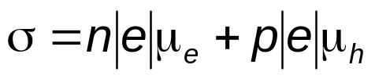
QUIZ week 14
The room-temperature electrical conductivity of an intrinsic silicon specimen is 500(ohm-m)⁻¹. Given values for the hole mobility μ_{h} and electron mobility μ_{e} are 0.16 and 0.075 m²/V-s, respectively.
Write a Matlab code to calculate the electron concentration.
Intrinsic là n= p
Extrinsic là n không bằng p

Slide 4
Issues to Addressed
Heat capacity
  atomic vibrations
  temperature dependence
  contribution of electrons
Thermal expansion
  connection to an harmonicity of interatomic potential
  linear and volume coefficients of thermal expansion
Thermal conductivity
  heat transport by phonons and electrons
Thermal stresses

Slide 5

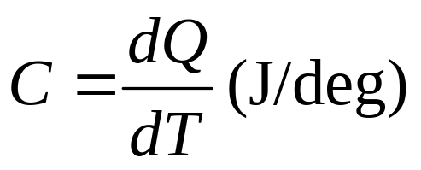
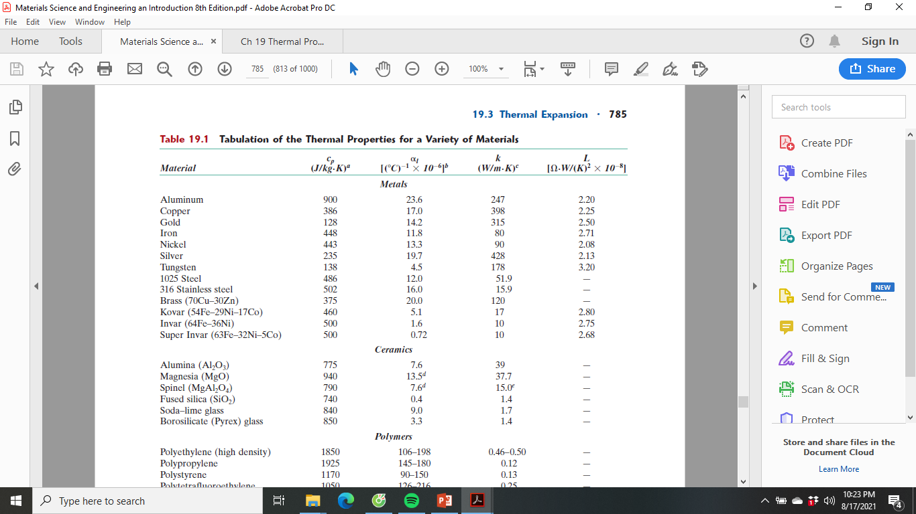
Heat Capacity
Heat capacity:
  is a property that is indicative of a material’s ability to absorb heat from the external surroundings;
  it represents the amount of energy required to produce a unit temperature rise.
  In mathematical terms, the heat capacity C is expressed as follows:
  T : thời gian, Q là energy cần để nó chảy ra
  where dQ is the energy required to produce a dT temperature change.
Specific Heat Capacity
c = (J/(Kg-K) ( capacity)

Slide 6
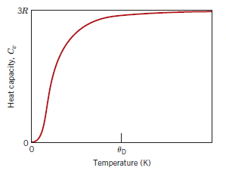
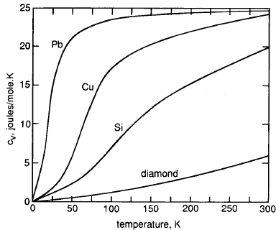
Temperature Dependence of the Heat Capacity
At K=0⁰, Cv=0
At K=θD, (Debye Temperature), the heat capacity level off

Slide 7

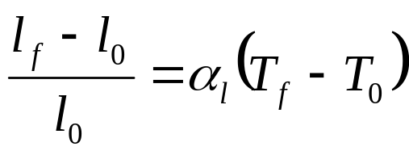
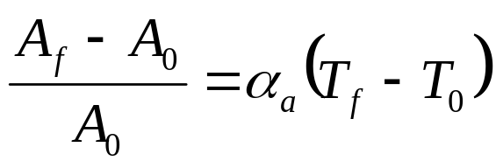
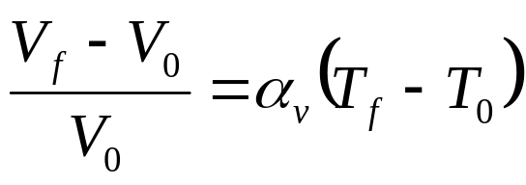
Thermal Expansion
Linear Expansion
Superficial Expansion
Cubical Expansion
α_{l} =linear coefficient of thermal expansion
α_{a} = superficial coefficient of thermal expansion
α_{v}=cubical coefficient of thermal expansion

Slide 8

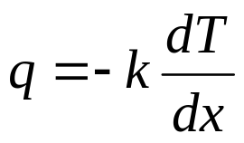
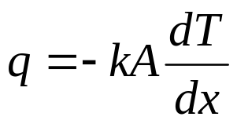
Thermal Conductivity
Thermal conduction is the phenomenon by which heat is transported from high- to low-temperature regions of a substance.
Fourier’s Law of Conduction
(Heat Flux or Heat Flow)
For 1 dimension
through a cross-section of the material
q: is the heat flow (W/m2) (Watt = Joule/sec)
k: is the thermal conductivity of the material
A: area of the cross-section

Slide 9

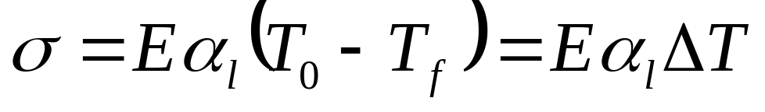
Thermal Stress
Magnitude of Stress
E: Modulus of Elastic
α_{l}: linear coefficient of thermal expansion

Slide 10
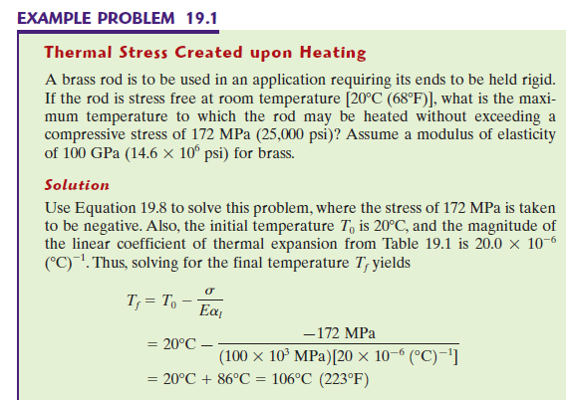
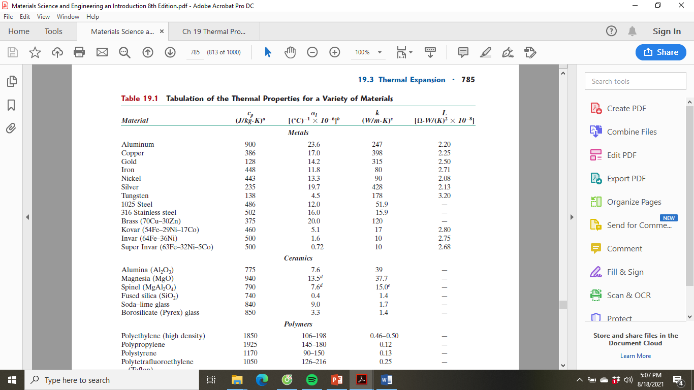

Slide 11
Write Matlab for example 19.1

Slide 12
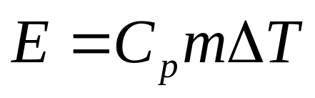
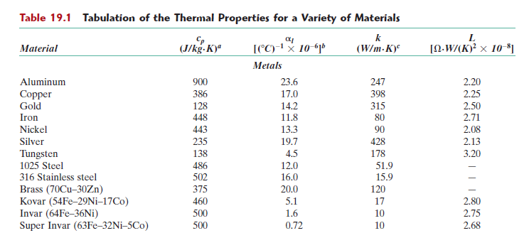
In class exercise
Write a matlab code to estimate the energy required to raise the temperature of 2 kg of aluminum from 20 to 100C.
E là năng lượng cần thiết, Cp: heat capaticy , m là khối lượng vật, delta T là nhiệt độ(Tf-To)

Slide 13
If a rod of 1025 steel 0.5m long is heated from 20 to 80C while its ends are maintained rigid, write a matlab code to determine the magnitude of stress that develops.
Hint: The Modulus of Elasticity for steel is in chapter 6.

Slide 14
HW
Reading: Chapter 9: Phase Diagrams
Read chapter 19
HW
19.1
19.7
19.14
19.25
(all the problems can be solved using MATLAB)
Core Problems: HW: Ch7 # 6,9,11, CH8 #16, 29
Self-help Problems:

